Slide 1
Spliny: a Shiny app to model non-linear relationships
using restricted cubic splines
Jordan Gauthier , MD, MSc
Assistant Member, Clinical Research Division,
Fred Hutchinson Cancer Research Center
Assistant Professor, Department of Medicine, University of Washington
R/Medicine 2019
Boston

Slide 2
How to better explore the relationship and predictive ability of a continuous variable and an outcome?
“all models are wrong, but some are useful”
George Box
Notes:
I became interested in how we could better model the relationship between a continuous variable and an outcome
What can we do to better model the relationship between a continuous variable and an outcome?

Slide 3
Assumptions of conventional modeling approaches
Continuous variables categorized:
Major information loss
All patients in the same category have the same association with outcome
Example: categorize age across 40
A 40-year-old same predicted risk as a 70-year-old
A 40-year-old different predicted risk than a 39-year-old
“Natura non facit saltus (Nature does not make jumps)”
Gottfried Wilhelm Leibniz
Altman DG et al. JNCI, 1994
Royston P et al. Statistics in Medicine, 2006
Altman DG et al. BMJ, 2006
Notes:
Unfortunately, an all-too-common practice is to ignore the continuous nature of the variable and to categorize it into groups, using arbitrary cutpoints.
First the cutpoints are always arbitrary, never replicate across study. This categorization leads to tremendous loss of informations. When one categorize, one makes the assumptions that all the patients in the same category have the same risk. Instead of being able to make potentially unique predictions for any value of the continuous variable, the model will only be able to make as many predictions as the number of categories

Slide 4
Assumptions of conventional modeling approaches
Linear relationship between the continuous variable and outcome
Y ~ 𝞫X
e.g. in logistic regression, a 1-unit change in the variable (X) associated with the same change in the odds of outcome (Y), regardless of where the variable “starts”
Pr(Outcome)
Continuous variable
Example: 1-unit increase in bilirubin leads to an increase in the odds of day-100 non-relapse mortality of 30%, this change in odds is the same if bilirubin increases from 1.2 mg/dL to 2.2 mg/dL as if bilirubin increases from 6.4 mg/dL to 7.4 mg/dL
Notes:
Another common approach is to assume a linear relationship between the continuous predictor and outcome. The rate of change does not vary; a 1-unit change in the continuous variable is associated with the same change in outcome, regardless of where the variable starts. in addition, this assume the relationship is monotonic, in other words that the relationship varies in only one direction.
While this assumption is frequently made, physicians are already familiar with a number of pathophysiological situation where this assumption is false

Slide 5
Relaxing the linearity assumption
Pr(Outcome)
Pr(Outcome)
Pr(Outcome)
Continuous variable
Continuous variable
Continuous variable
e.g. O2-Hb dissociation curve,
drug PK/efficacy relationship
e.g. Electrolyte serum concentration
e.g. activation-induced cell death
Notes:
Physicians and biologists are nonetheless already familiar with non-linear effects. Many of us have learnt the sigmoid shape of the O2-Hb dissociation curve. Another example is the relationship between the peak concentration of a drug and its efficacy

Slide 6
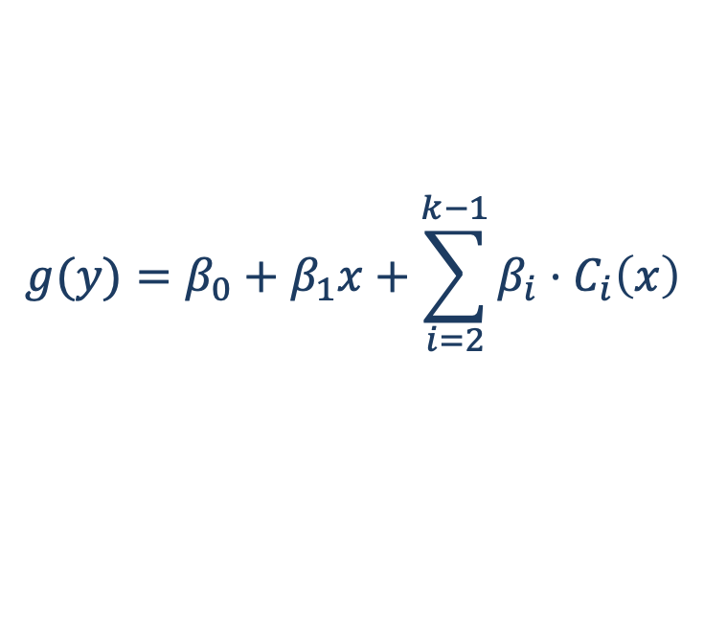
Restricted cubic splines
Flexible tool to model complex non-linear relationships between a continuous variable and an outcome
Limited assumptions
$$g(y)=β_{0}+β_{1}x+\sum_{i=2}^{k−1}{β_{i}}⋅C_{i}\left(x\right)$$
k: knot number
C_{i}(x): cubic component for the i^{th} window
g: link function
Linear
Linear
Stone et al. Proceedings of the American Statistical Association 1985
Devlin TF. Proceedings of the 11th Annual SAS Users Group International Conference 1986
Heinzl H et al.Computer Methods and Programs in Biomedicine 1997
Harrell JFE. Regression Modeling Strategies. Springer 2015
Notes:
Restricted cubic splines are made of an intercept, a linear component and a number of cubic components. They are basically piecewise polynomials smoothed with each other, attached a least-square linear regression lines at the tails.
C_{i}(x) is the cubic component that falls in the i^{th} window, and g is a so-called link function (for example, for logistic regression g is the “logit” (see below) of the probability of outcome, and for Cox regression g is the so-called log-log transformation of the survivor function).

Slide 7
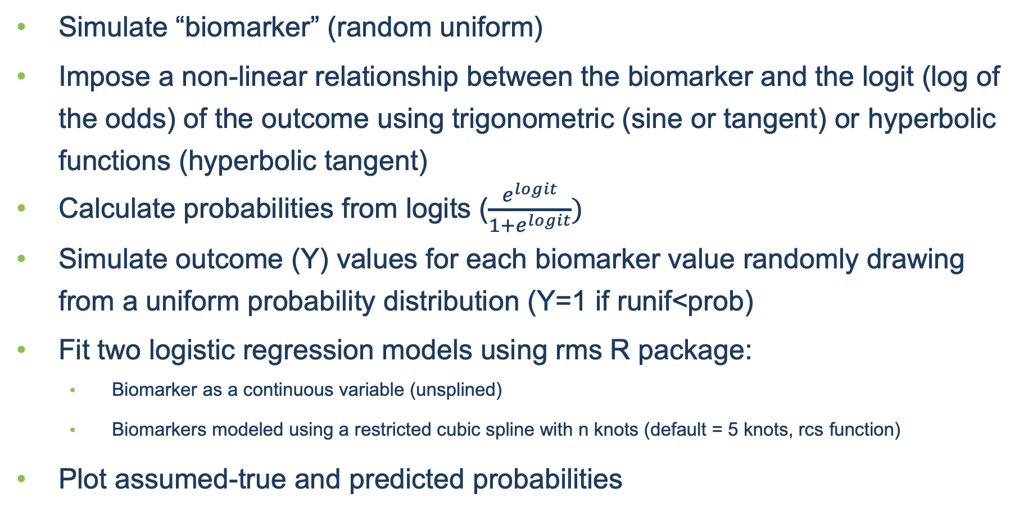
“Under the hood”
Simulate “biomarker” (random uniform)
Impose a non-linear relationship between the biomarker and the logit (log of the odds) of the outcome using trigonometric (sine or tangent) or hyperbolic functions (hyperbolic tangent)
Calculate probabilities from logits ($\frac{e^{logit}}{1+e^{logit}})$
Simulate outcome (Y) values for each biomarker value randomly drawing from a uniform probability distribution (Y=1 if runif<prob)
Fit two logistic regression models using rms R package:
Biomarker as a continuous variable (unsplined)
Biomarkers modeled using a restricted cubic spline with n knots (default = 5 knots, rcs function)
Plot assumed-true and predicted probabilities

Slide 8
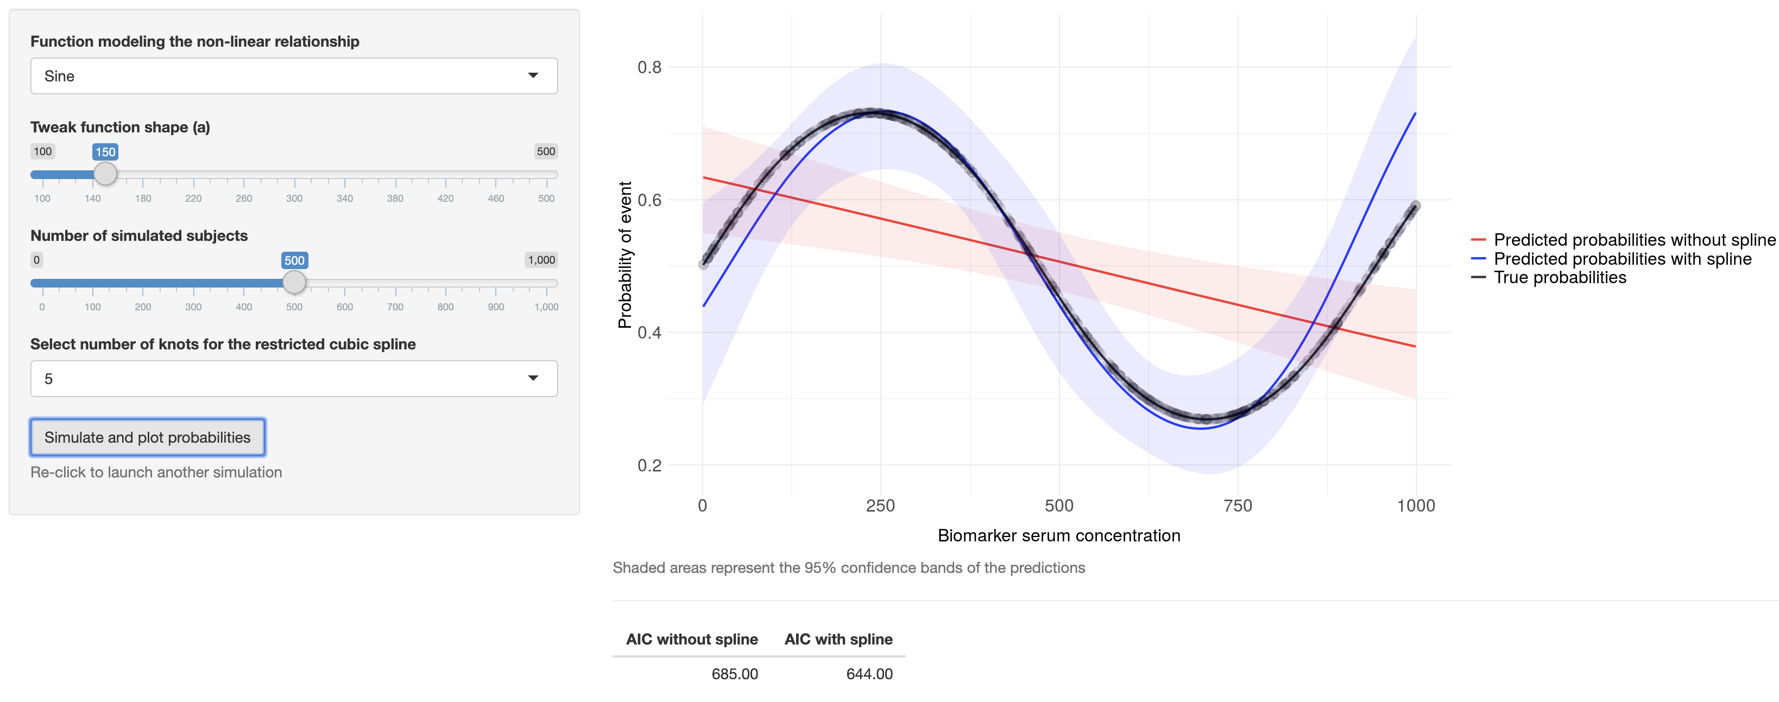
Spliny: restricted cubic splines to model non-linear effects using logistic regression
Shaded areas represent the 95% CI of the estimates

Slide 9
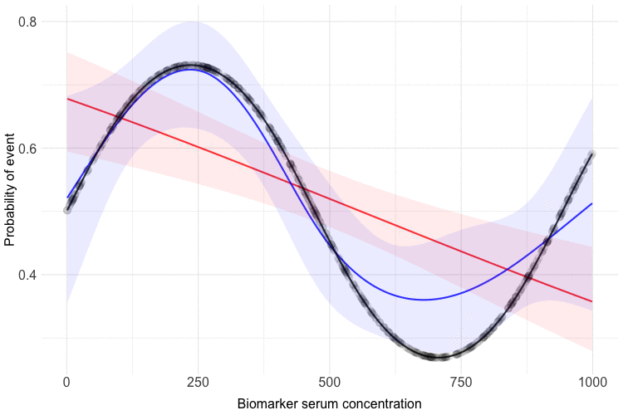
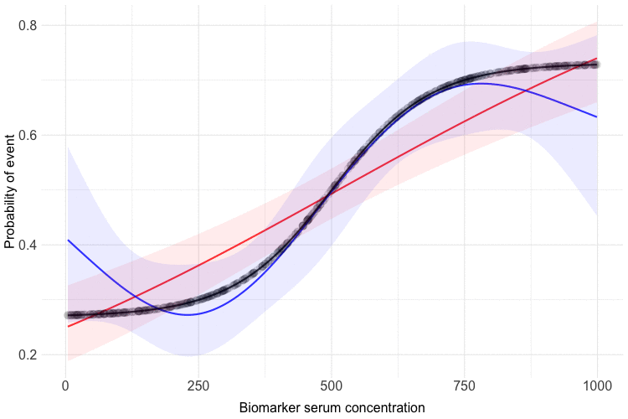
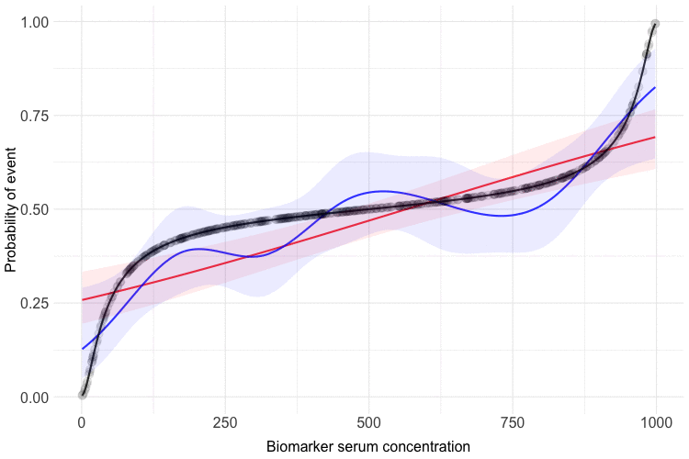
Spliny in action
Pr(event)
Pr(event)
Pr(event)
Biomarker serum concentration
Biomarker serum concentration
Biomarker serum concentration
Notes:
Overall the user can quickly simulate multiple datasets and multiple fits, interacting with the shape of the relationships. One can appreciate the spline fits the data better than the model imposing a linear relationship.

Slide 10
Spliny - summary
Visualize and interact with various non-linear relationship shapes
Visualize the advantages of modeling non-linear relationships
Visualize overfitting
Popularize the use of restricted cubic splines for biomedical research

Slide 11



Links
https://drjgauthier.shinyapps.io/spliny/
https://github.com/drjgauthier/spliny/blob/master/app.R
@drjgauthier
Acknowledgements
Ted Gooley
Vicky Wu
Frank Harrell

